Slide 1




OPEN-SOURCE INTELLIGENCE (OSINT) 4N00BS
TECH TALK
HACKERCATZ PRESENTS…
Kiowa Scott-Hurley

Slide 2




Disclaimer
???
Notes:
I am learning about all of this as we speak.
I am NOT an expert!

Slide 3
OS-what???
01
Notes:
What’s OSINT anyway?

Slide 4




GEOINT
NUCLEAR
SOCMINT
ACOUSTIC
IMINT
OSINT
MASINT
RADAR
SIGINT
INFRARED
HUMINT
TELEMETRY
Notes:
Well, there’s many types of intelligence out there actually.

Slide 5
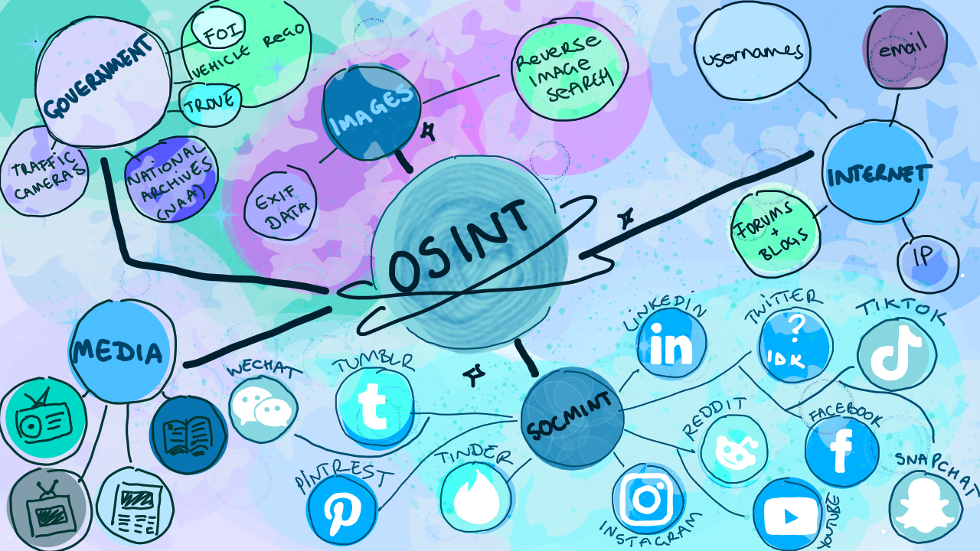

Notes:
…and there’s a lot just within OSINT.
OSINT is all about open source intelligence – stuff you find on the web, in library archives, on government sites…
Raw data is one thing (000000)
Information is another (the knowledge that the number is my facebook profile ID)
Intelligence is information for a purpose – maybe you want my facebook ID to see how I engage with brands online to buy me a great birthday present.
This is important, because turning a mass of data into information into intelligence is big work with the amount of data available now.

Slide 6
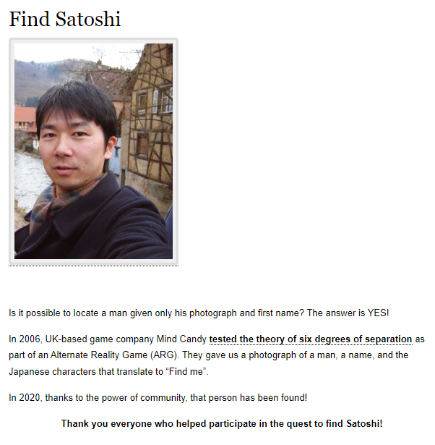

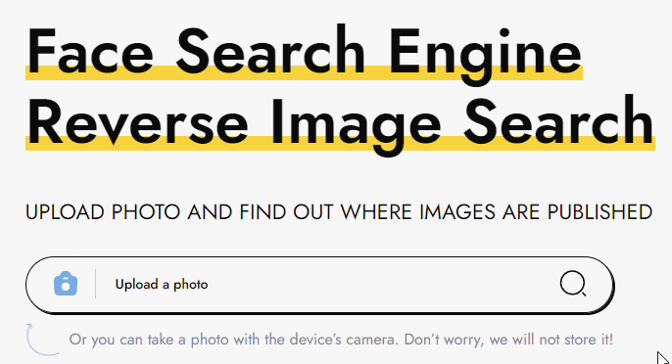
Find Satoshi
Notes:
https://findsatoshi.com/

Slide 7





WHY SHOULD I CARE?
SECURITY AWARENESS
THE BUS
OFFENSE
Notes:
Knowing what tools exist out in the wild can help us protect ourselves when we share information online, in person, etc.,
The Bus: I once caught a bus with someone who obviously worked for Defence – he had the lanyard, the camo pants, scrolled military subreddits, had Defence branded debit cards in his phone wallet… This marked him as a careless target.
Obviously people use open source intelligence to help them commit cyber-crime, or lawful pentesting activities.

Slide 8

STEPS OF OFFENSE
CLEANING UP
ATTACKING
RECONAISSANCE AND SCANNING
PLANNING
Gaining and maintaining access, moving sideways
What are you aiming for?
Notes:
OSINT falls into the reconnaissance phase of “cyber offense” or pentesting activities. There are better diagrams than this one (Lockheed Martin Cyber Kill Chain, MITRE ATT&CK framework).

Slide 9

TOOLS
02
Notes:
So what tools can you use for OSINT?

Slide 10
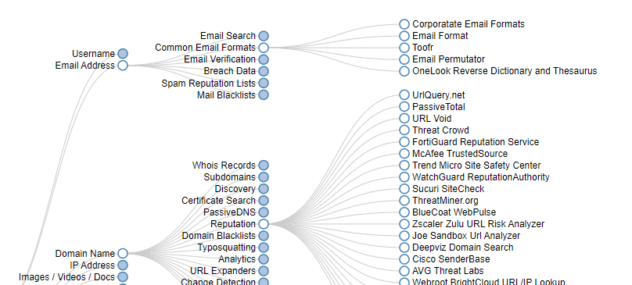
OSINT Framework
Notes:
https://osintframework.com/
This website helps give you tools depending on the info you have access to.

Slide 11




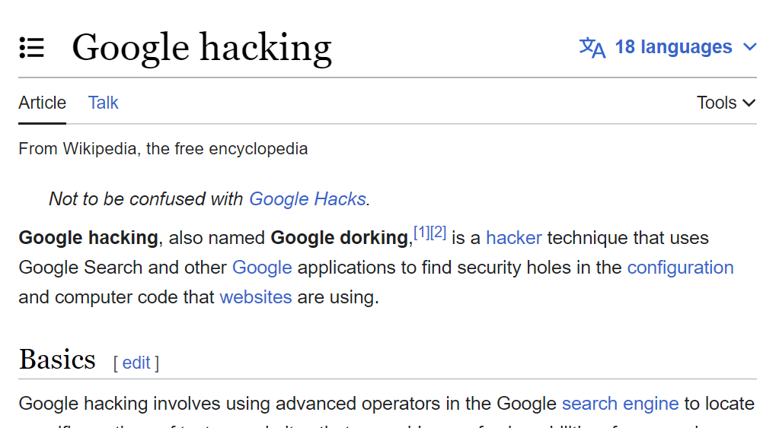






GOOGLE DORKING
And other search engines…
Notes:
USE GOOGLE! (…and other search engines).

Slide 12

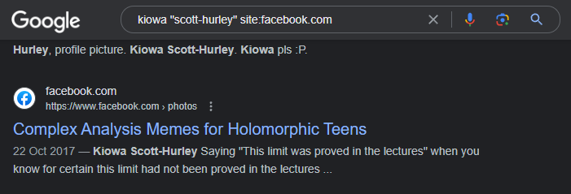
Notes:
If you search for me, and don’t wrap my last name in quote marks, you’ll get results for people named Scott in Iowa.
You can use google dorking techniques like “site:facebook” to dig up my embarrassing facebook history. You can also use things like “filetype” or Boolean values.

Slide 13
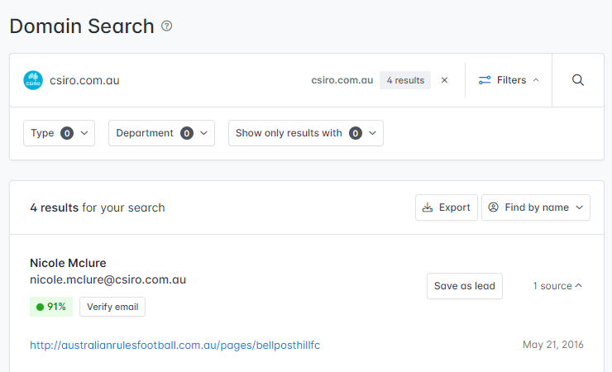


Emails
Notes:
https://hunter.io/search/
https://phonebook.cz/
The tools listed here are all about grabbing lists of emails based on domains – this might be useful if you’re hunting down someone from HR, or find interesting email domains tied to machines.

Slide 14
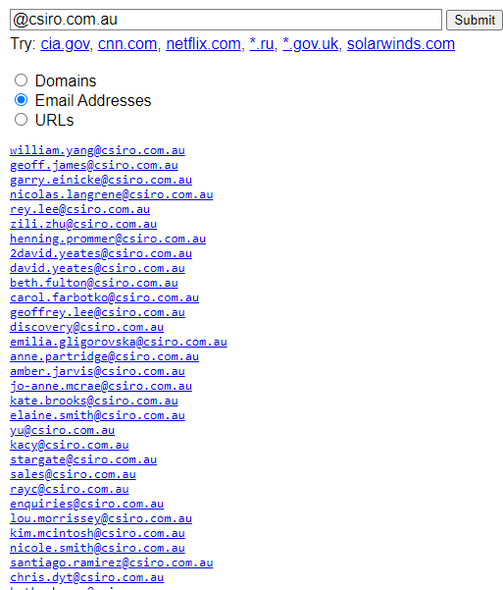
Notes:
Screenshot of phonebook.cz results for csiro.com.au

Slide 15
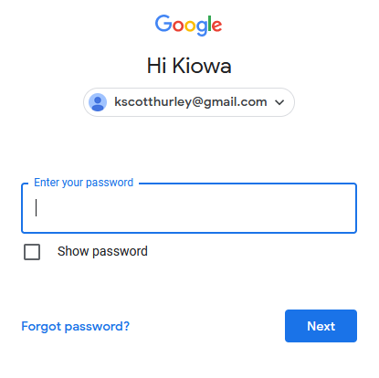
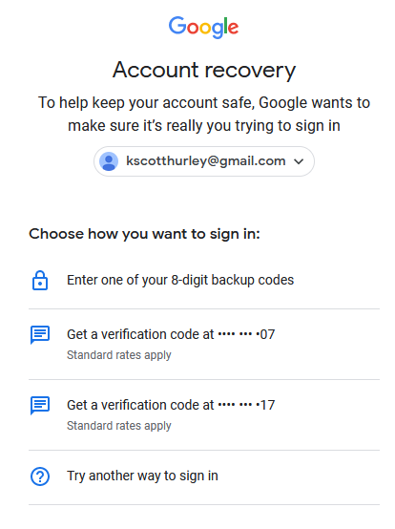
Notes:
Get creative – if I try to log in to my Google account, it greets me by name (Kiowa), confirming it’s probably my account.
The recover account options also leaks information, such as the gist of my phone numbers. In some cases it will list sections of linked email addresses, which can make this an effective way to link an email address back to an email address you have confirmed belongs to someone.

Slide 16
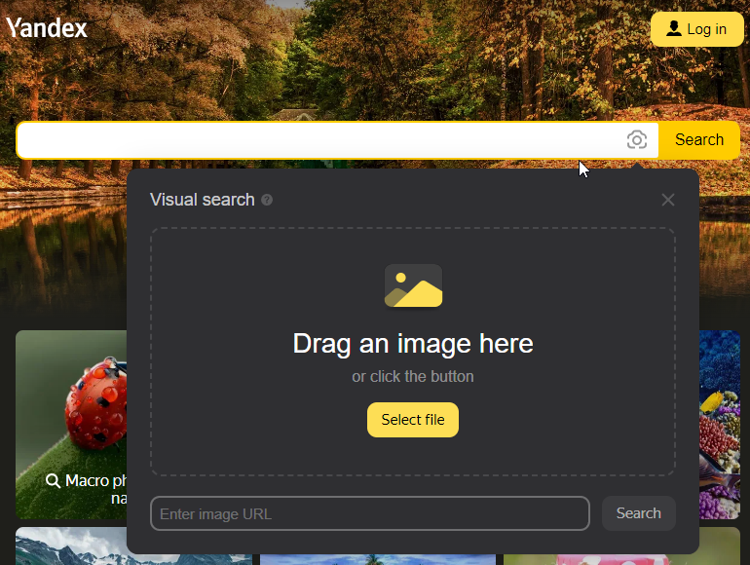
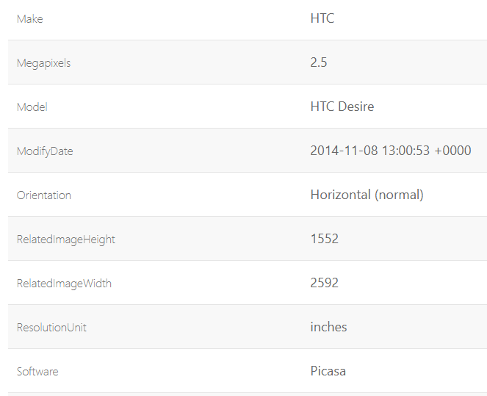
Images
Notes:
Reverse image search is obviously very powerful for info gathering – I’ve found Yandex is great for this.
Images also have a bunch of metadata (EXIF data) attached to them. There are several webtools for doing this.
Note that newer images leak less data and are far less likely to include stuff like location data.
In the EXIF example here, you can see that in 2014 I had a HTC Desire based on a generic image of the sky I took in 2014 which I uploaded ☺

Slide 17
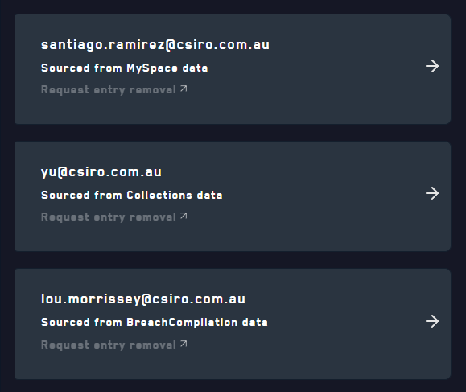

DeHashed
Notes:
DeHashed is a great tool for drawing together loads of info – you can search names, usernames, emails, bitcoin wallet addresses, ip addresses, hashed passwords or raw passwords…
This can automate and streamline a lot of searching and dig up new threads.
One person I looked into had a “child account” attached to their email in their child’s name. I knew it was their child because their childrens’ names were on their Facebook. When I dug into their child’s email, I found the parents phone number – an Optus number. Suddenly, with a big of light digging in DeHashed, I know this person may be wrapped up in the recent Optus breach.

Slide 18
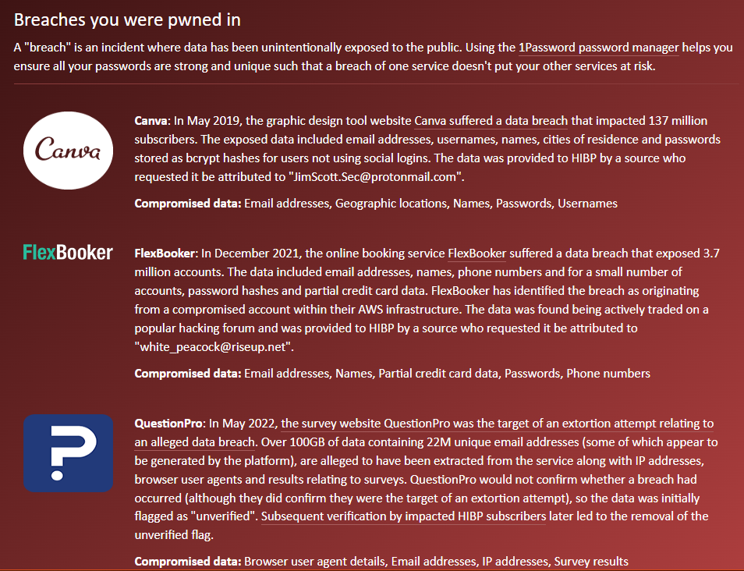
Haveibeenpwned?
Notes:
HaveIBeenPwned is a great tool for seeing what breaches an email has been associated with.

Slide 19
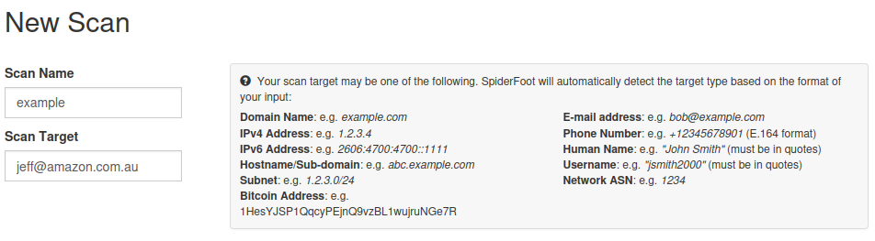
Spiderfoot
Notes:
Spiderfoot is a bit like DeHashed in terms of automating info gathering.
It’s a tool that you can either install into Kali Linux, or comes preinstalled, depending on the version.

Slide 20
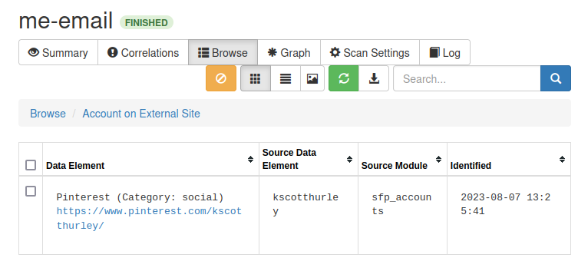
Notes:
For example – if you search my email in Spiderfoot, you can find my long defunct Pinterest account.

Slide 21
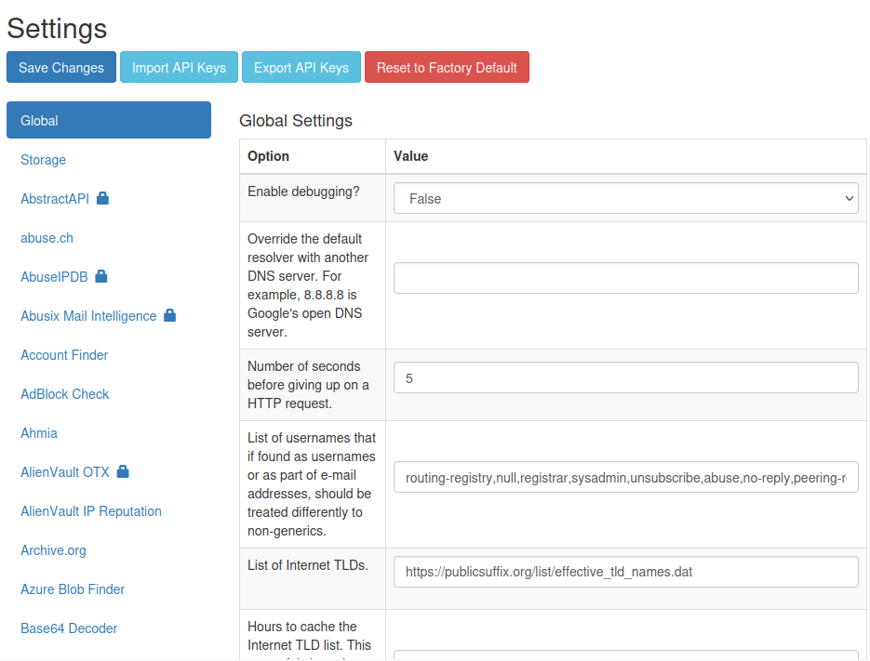
Notes:
If you have API keys (paid or free), give them to Spiderfoot and it will crawl more databases.

Slide 22
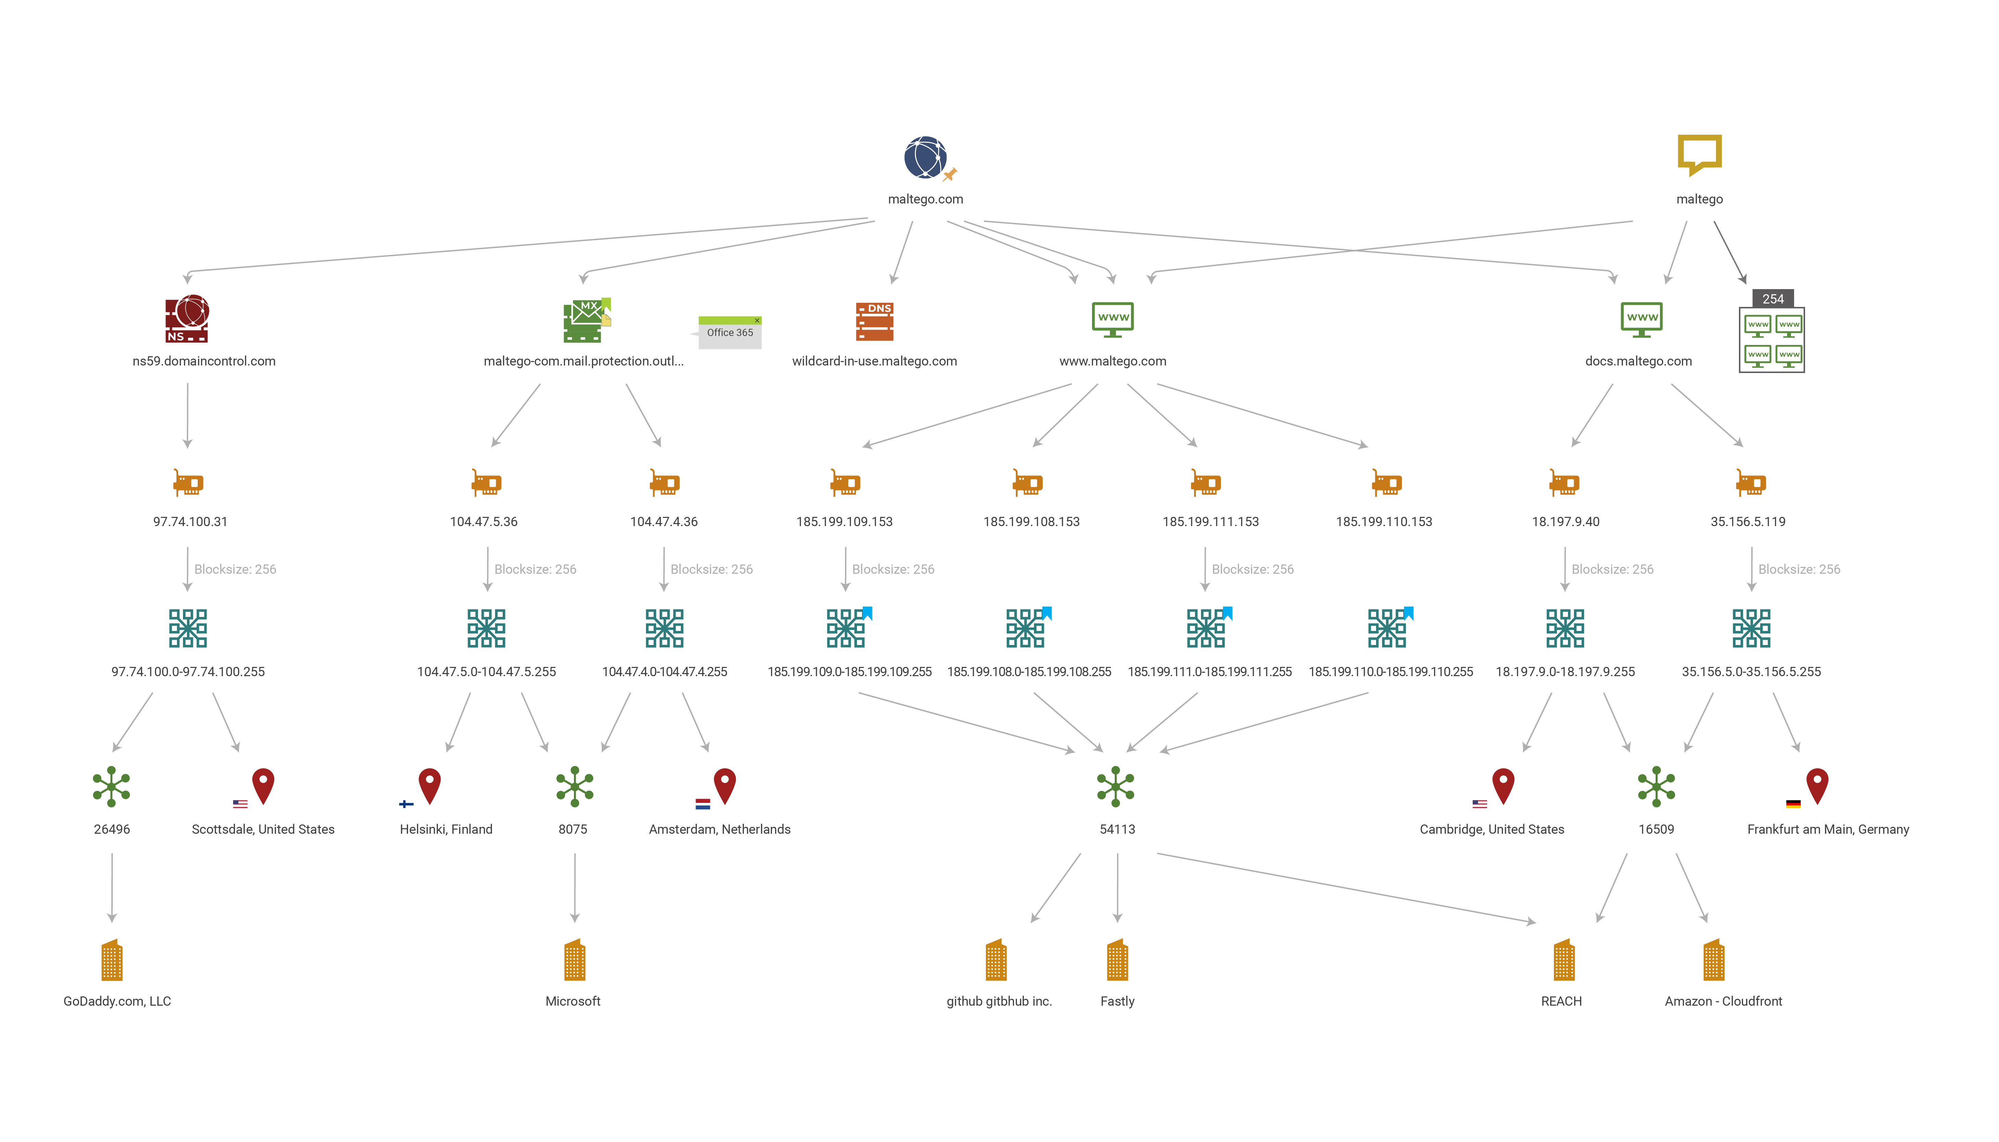
Maltego
Notes:
By Maltego - Own work, CC BY-SA 4.0, https://commons.wikimedia.org/w/index.php?curid=92094153
Maltego is another tool, more focused on gathering information about the tech than the people, and presenting it neatly.

Slide 23
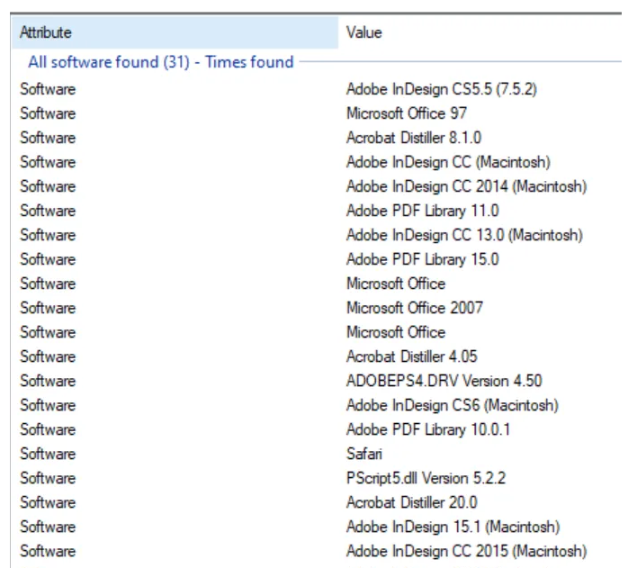
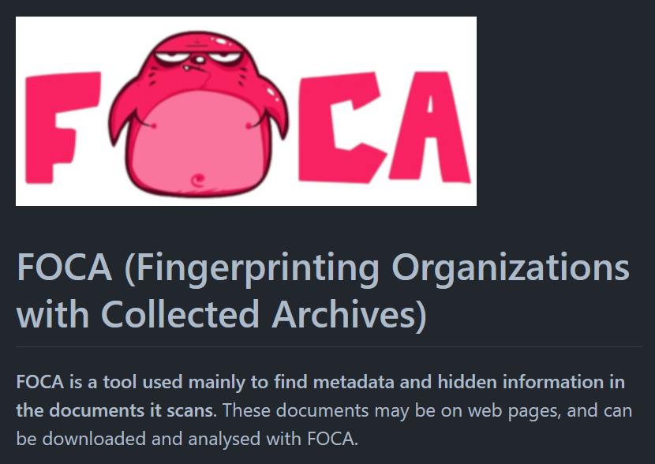
FOCA
Notes:
https://github.com/ElevenPaths/FOCA
As it says on the slide – if you see a bunch of documents on a website that have been created with specific software (Adobe products for example), you can search for vulnerabilities in that software, or you might be aware of the big Adobe passwords breach and use that knowledge to your advantage.

Slide 24
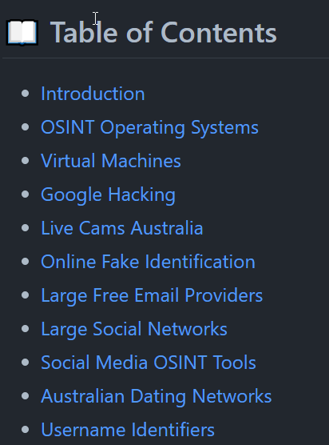
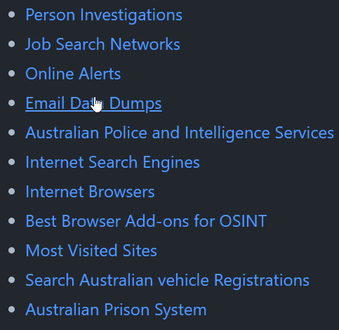
DFW1N-OSINT
Notes:
https://github.com/DFW1N/DFW1N-OSINT
GitHub repository with Aussie-centric OSINT tools – most stuff online assumes you’re in the US.

Slide 25

CHALLENGE
03

Slide 26

OSINT: HUNTING YOUR OWN DATA
Try hunt down your own personal data on the web – you might be shocked what you can find about yourself!
Notes:
The challenge? Go hunting for yourself online! What can you find?
When I did this exercise I saw people had written blog posts, Instagram posts, etc., mentioning me… without ever letting me know.

Slide 27

Notes:
For example - In 2015 the local newspaper included an article about me which has since been scanned and put online.
I don’t remember ever knowing about this in 2015!

Slide 28

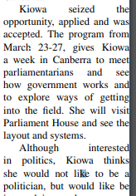
Notes:
I still don’t want to be a politician ☺

Slide 29
THANKS!

Slide 30
Notes:
Slides from SlidesGo – they have all sorts of cool stuff.
Cats from me.

